Slide 1
Machine Learning
Final Presentation:
Artificial Neural Network
Student: Vinícius Santana da Silva Brandão
Professor: Daniel de Filgueiras Gomes

Slide 2
The problem - Phone Price Classification
In this problem, we want to make an estimation of mobile phone prices based on their features (such as RAM, Internal Memory) in a competitive market. To accomplish this, we aim to analyze sales data from various mobile phone companies. The goal is to establish a relationship between specific features and the selling price, ultimately providing a price range that indicates the relative level of pricing.

Slide 3
About the dataset
The dataset has 20 characteristics plus the classification, all of them were used to solve the problem. The characteristics were all phone specifications such as battery capacity, clock speeds, camera resolutions, dimensions, wifi and more. There are 4 different price categories, numbered from 0 to 3.

Slide 4
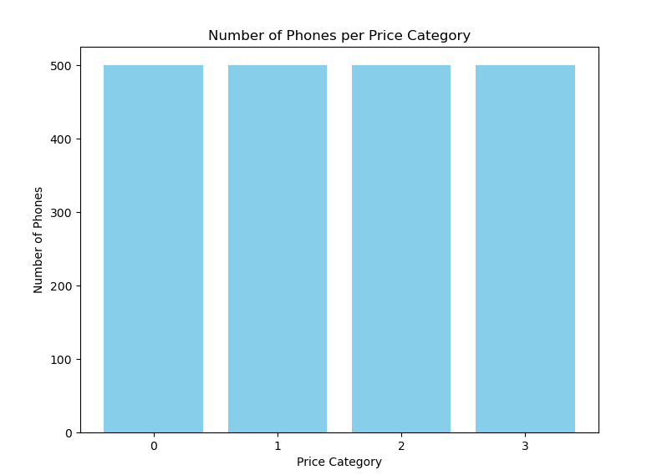
Phones by price category, evenly distributed. 4 categories with 500 phones each

Slide 5
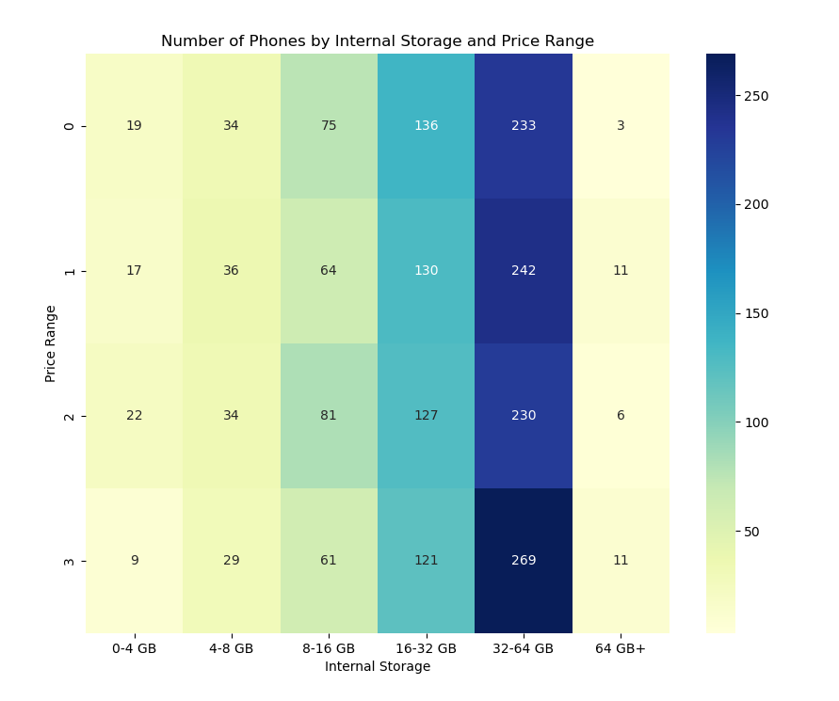
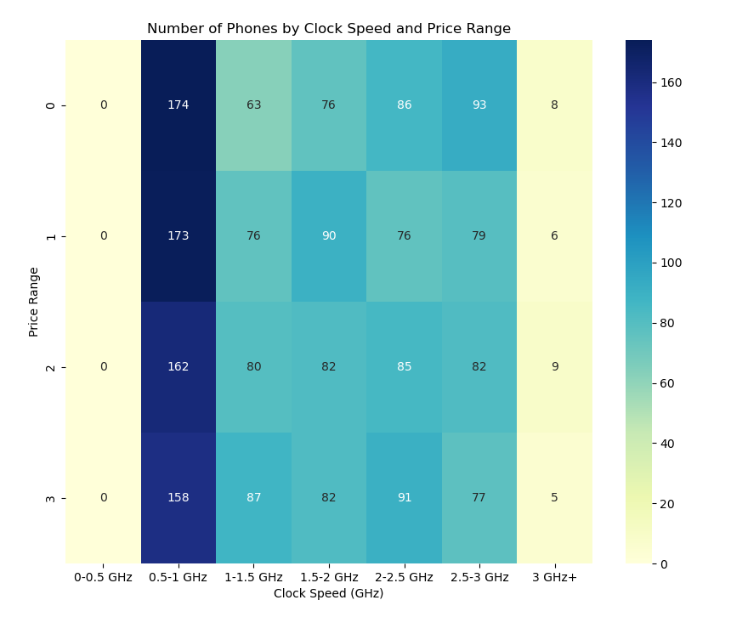
Distribution of not so useful data

Slide 6
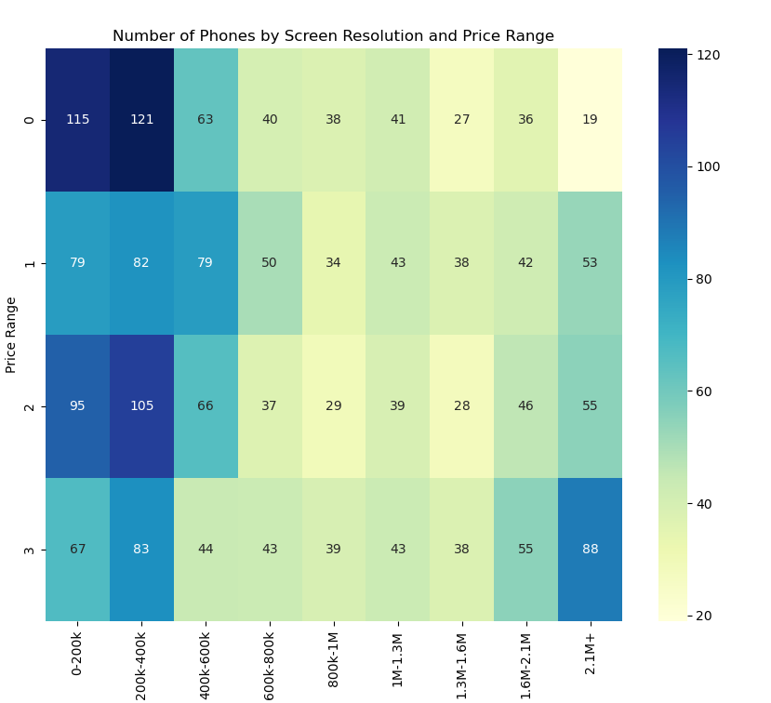
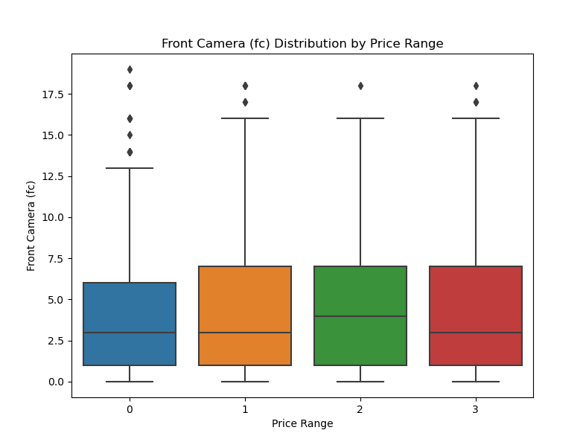
Distribution data more useful data

Slide 7
The fed data
The inputs given to the network were all the phones’ characteristics normalized They were all normalized using
x normalized = (X - mean) / std.
In total, there were 2000 phones evaluated separated in a train set (1600 phones) and 2 test sets (200 phones each)
The outputs were the estimation for each phones’ categories.

Slide 8
The solution process
To solve this simple problem, not more than a simple solution is required. So, the objective was to use an artificial neural network with at least 1 hidden layer, optimization and different activation functions, so that they could be utilized to their best cases.
Unfortunately, no regularization or cross validation was implemented.

Slide 9
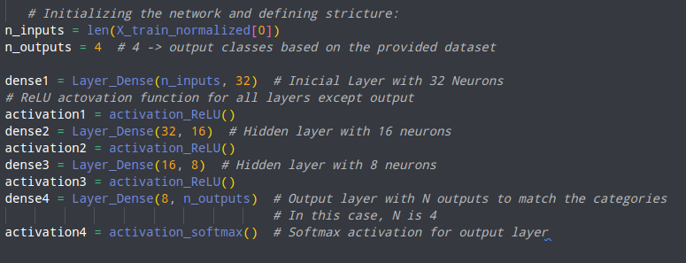
The neural network
The chosen network has 2 hidden layers, an input layer and an output layer. The activation functions chosen for the input and hidden layers were ReLU and the output layer used a softmax function.

Slide 10

The parameters chosen
0.1 Learning rate brought a good result, with quick convergence and a satisfactory precision for this project’s intent.
1500 epochs is a little further than what would be optimal for this problem, but is better for graph visualization.
The train/test split was 80% train and 20% test, no extra validation method was introduced for training. This has probably induced a larger training bias than if it had some validation method

Slide 11
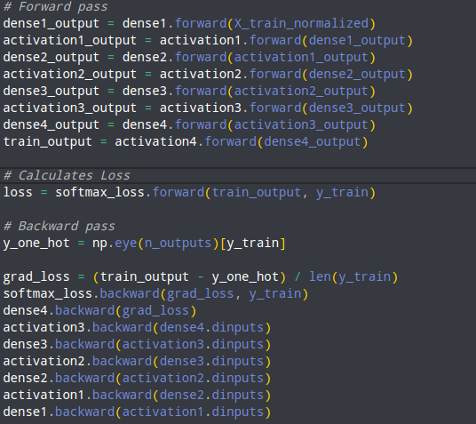
More about the neural network
The network is being trained using batches, which is going to update the weights and biases only once for every dataset pass.
The back propagation is being done manually, calculating loss, using a -log(correct class confidence) function, which is in itself a simplification of the categorical cross entropy function for machine learning.
This loss is applied in the backward pass to update the network’s information and enforce the learning process.

Slide 12
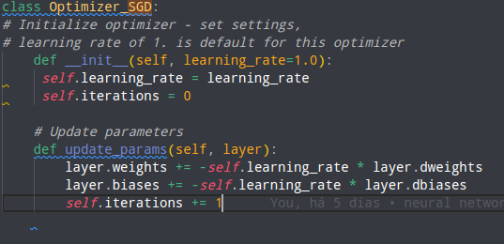
Optimization
The optimization is made via Stochastic Gradient Descendent (SGD), which seeks to find the global minimum for the loss function, bringing the closest possible network to it’s optimal results. The learning rate will adjust the intensity with which the network will be updated in each epoch.
Good learning rate examples:
Good Learning Rate
Good Enough Learning Rate

Slide 13
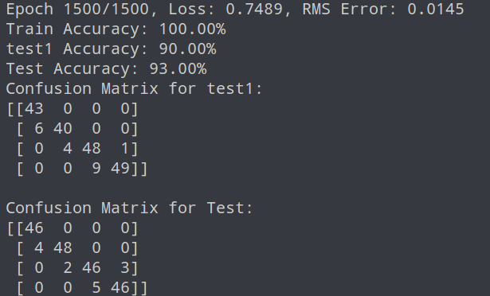
Results: accuracy and confusion matrix
These are the final results for the training with the configurations shown in this presentation. This is a good enough accuracy for test and test1.
The mislabeling happens mainly with adjacent groups, and the network is biased towards classifying down the phones, with 30 downwards classifications and 4 upwards in this particular setting.

Slide 14
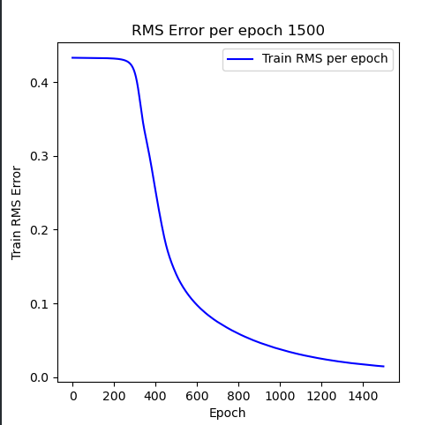
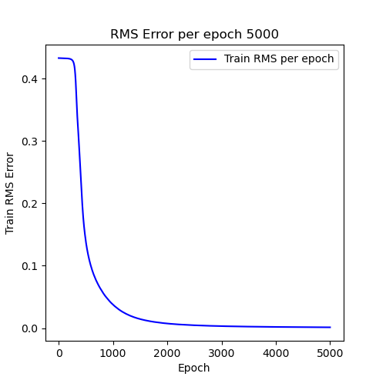
Results: RMS error per epoch
The RMS error converges around 1500 ~ 2000 epochs on the training data, showing no more significant progress over 2000 passes.

Slide 15
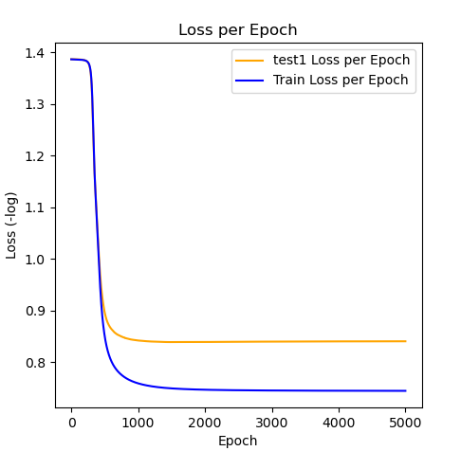
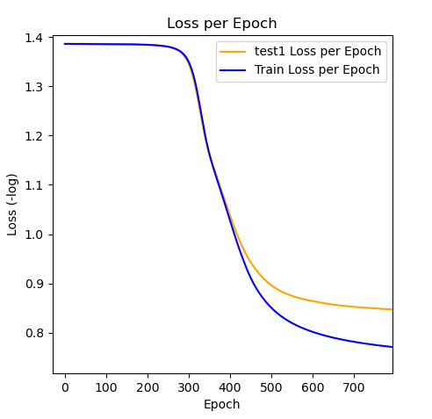
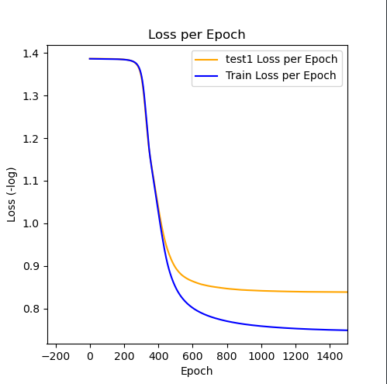
Results: Loss Per Epoch
The loss converges between 700 ~ 1500 epochs, for the training dataset and between 400 and 800 for the test1 set.
This means that over a 1500 pass run, the network is overfitted, but it is still very effective given the results shown previously

Slide 16
Questions

Slide 17
Sources & code
Problem:
Mobile Price Classification
consulted material:
Neural Networks from Scratch
The code is available at:
https://github.com/TeuPremium/Phone_Price_Prediction
student email:vinicius.brandao@ufpe.br

